Slide 1
Objectives
In this session, you will learn to:
  Define the HTTP endpoints
Notes:
Start the session by sharing the objectives with the students.

Slide 2

Introduction to HTTP Endpoints
What is HTTP?

Slide 3

Introduction to HTTP Endpoints (Contd.)
HTTP is a protocol used for communication over the Internet.

Slide 4
Introduction to HTTP Endpoints (Contd.)
What is an endpoint?

Slide 5
Introduction to HTTP Endpoints (Contd.)
An endpoint is a service that listens the client requests natively.

Slide 6
Introduction to HTTP Endpoints (Contd.)
SQL Server 2005 supports the concept of an endpoint.
Each endpoint supports:
  A protocol, which can be TCP or HTTP.
  A payload type, which can include support for database mirroring, service broker, T-SQL, or SOAP.

Slide 7
Introduction to SOA
Let us now discuss about Service Oriented Architecture (SOA).

Slide 8
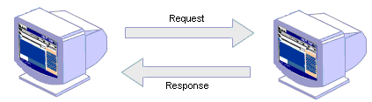
Introduction to SOA (Contd.)
SOA:
  Is an extension of distributed computing based on the request/reply design pattern.
  Involves the following types of entities:
    Service provider
    Service consumer
Service consumer
Service provider

Slide 9
Introduction to SOA (Contd.)
Benefits of SOA:
  It allows you to create objects, such as Web services that can be accessed from heterogeneous systems.
  It enables you to create applications that reuse the existing business logic.
  It enables changes to applications while keeping clients or service consumers isolated from the changes.

Slide 10
Introduction to Web Services
Let us now discuss about Web services.
Notes:
Do not go into the depth of SOAD, WSDL, and UDDI. Just try to clear the concept of Web Services to the student.

Slide 11
Introduction to Web Services (Contd.)
Web service:
  Is a collection of Web methods accessible over the Internet.
  Is based on SOA.
  Uses the following open standards:
    SOAP
    UDDI
    WSDL
Notes:
Do not go into the depth of SOAD, WSDL, and UDDI. Just try to clear the concept of Web Services to the student.

Slide 12
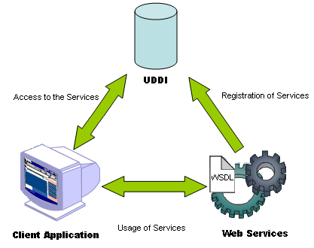
Introduction to Web Services (Contd.)
Implementation of a Web service in the distributed environment:
Notes:
Do not go into the depth of SOAD, WSDL, and UDDI. Just try to clear the concept of Web Services to the student.

Slide 13
Introduction to Web Services (Contd.)
SOAP:
  Is a protocol used for exchanging information in a distributed environment.
  Is an XML-based message envelop based on HTTP.
UDDI:
  Is a registry where a Web service is published.
  Helps the client applications to locate the published Web services.
WSDL:
  Is a document in XML format that describes the Web service.
  Helps Web clients to retrieve information about the names of the Web methods and their parameters.
Notes:
Do not go into the depth of SOAD, WSDL, and UDDI. Just try to clear the concept of Web Services to the student.

Slide 14
Introduction to Web Services (Contd.)
Flash presentation: Implementing Web services
Notes:
Refer SG to explain

Slide 15
Introduction to Web Services (Contd.)
Benefits of Web services:
  Interoperability
  Multilanguage support
  Reusability
  Use of industry-supported standards
Notes:
Do not go into the depth of SOAD, WSDL, and UDDI. Just try to clear the concept of Web Services to the student.

Slide 16
Introduction to Web Services (Contd.)
Benefits of Web services:
  Interoperability
  Multilanguage support
  Reusability
  Use of industry-supported standards
Web service can be used by any client application that can communicate through HTTP.
Notes:
Do not go into the depth of SOAD, WSDL, and UDDI. Just try to clear the concept of Web Services to the student.

Slide 17
Introduction to Web Services (Contd.)
Benefits of Web services:
  Interoperability
  Multilanguage support
  Reusability
  Use of industry-supported standards
Web service can be created by using any programming language.
Notes:
Do not go into the depth of SOAD, WSDL, and UDDI. Just try to clear the concept of Web Services to the student.

Slide 18
Introduction to Web Services (Contd.)
Benefits of Web services:
  Interoperability
  Multilanguage support
  Reusability
  Use of industry-supported standards
A Web service created for a particular application can be reused in other applications.
Notes:
Do not go into the depth of SOAD, WSDL, and UDDI. Just try to clear the concept of Web Services to the student.

Slide 19
Introduction to Web Services (Contd.)
Benefits of Web services:
  Interoperability
  Multilanguage support
  Reusability
  Use of industry-supported standards
All of the major vendors support Web service-related technologies, such as HTTP, XML, and SOAP. This enables heterogeneous applications access Web service very easily.
Notes:
Do not go into the depth of SOAD, WSDL, and UDDI. Just try to clear the concept of Web Services to the student.

Slide 20
Introduction to Web Services (Contd.)
Web services in SQL Server:
  The following database objects can be exposed as a Web service:
    Transact-SQL batch statements, with or without parameters
    Stored procedures and scalar-valued user-defined functions
Notes:
Do not go into the depth of SOAD, WSDL, and UDDI. Just try to clear the concept of Web Services to the student.

Slide 21
Just a minute
Which of the following options describes the Web services?
  1. WSDL
  2. SOAP
  3. UDDI
Solution:
  1. WSDL

Slide 22
Just a minute
Which of the following options helps in finding a Web service?
  WSDL
  SOAP
  UDDI
Solution:
  3. UDDI

Slide 23
Summary
In this session, you learned that:
  A Web service is the piece of code that is exposed over the Internet.
  Web services have following advantages:
    Interoperability
    Multilanguage support
    Reusability
    Use of industry-supported standards
  SOAP is a standard communication protocol to interchange information in a structured format in a distributed environment.
  WSDL is a markup language that describes a Web service.
  UDDI provides a standard mechanism to register and discover a Web service.
Notes:
You can summarize the session by running through the summary given in SG.
In addition, you can also ask students summarize what they have learnt in this session.

